Slide 1
Bus Alert
David Pennington, Alex Henry, Robert Burrus

Slide 2
Us

Slide 3


Our Customer
Nick Such – Awesome Inc.
Awesome Inc. is a local company that focuses on the encouragement of entrepreneural ventures, especially from a technological realm
Chase Southard – OpenLexington
OpenLexington is a group of developers that aims to improve the technological functionality of Lexington as a city.

Slide 4
Goals
Create a project that will have a positive impact on the way of life for the government, community, or population of Lexington
Design project around the idea of continual use. Our project should be functional and easily maintainable after our development is concluded

Slide 5
Decision
Decided early on mobile development
Initial Brainstorming: Trash pickup App, City Council App, Bus Alert app
Checked OpenLexington.org for existing projects

Slide 6

Bus Alert!
Previously existing project
Decision to start over
Multiple platforms

Slide 7
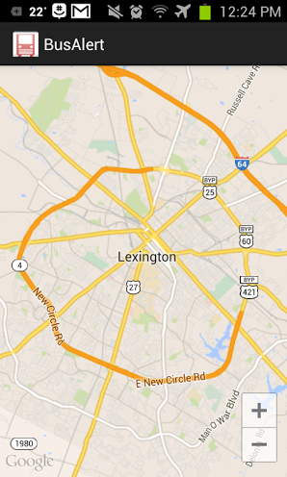
Bus Alert Requirements
Live map of busses and stops. Lextran
tracker data ported to mobile for
usability
Subscription service with notifications

Slide 8
Bus Alert Technologies
Languages: Java, Objective-C, XML
APIs: Google Play Services, Lextran API using XML parsing
Tools: Jekyll for website creation
Source Control: Leaning heavily on Github for both SC and website hosting

Slide 9
Status
Android and iOS skeletons have been created
Have menu setup and map display on Android
Have data input and map display on iOS

Slide 10
Challenges This Far…
Google’s Android Play Services tutorial was wrong...
iOS…
Next step will be working with Lextran’s API and parsing XML to get info to overlay on map

Slide 11
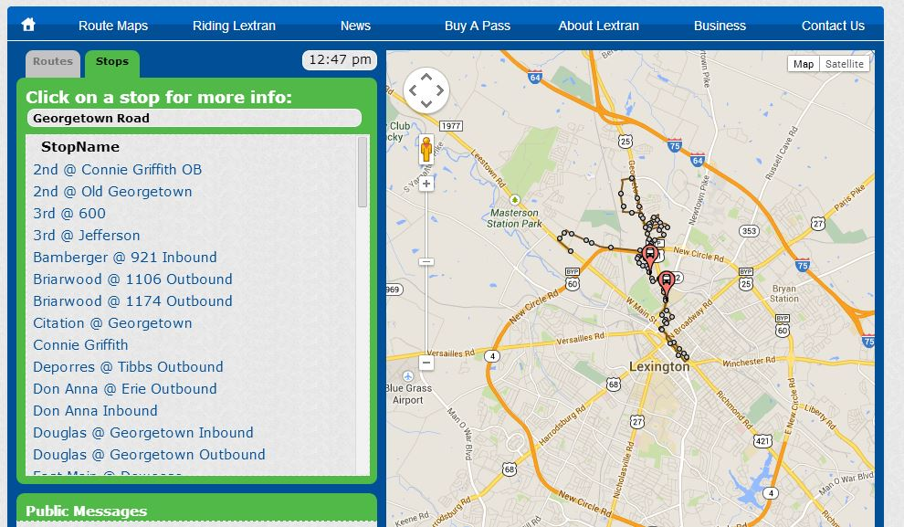
Lextran Webapp Tracker

Slide 12
Customers and Future…
Customers are students and citizens of Lexington with Android or iOS phones that utilize the city bus service
Future group development could be an accompanying webapp that would allow text alerts for citizens without smartphones

Slide 13
Thanks

